Slide 1
The Future of the Web: From Cloud to Edge
Server-Side Components, React 18, and Next.js 13

Slide 2
The Future of the Web
The web is constantly evolving and improving. In the future, the web will be faster, more secure, more accessible, and more user-friendly. The web will use artificial intelligence, machine learning, and virtual reality to enhance the user experience.
The web will also become more personalized and interactive, allowing users to customize their experience. Additionally, the internet of things will become more prevalent, connecting everyday objects and making them smarter.
Finally, the web will become more decentralized, allowing users to have more control over their data and privacy.

Slide 3
What Is Edge Computing
Edge computing is a distributed computing model that moves computational workloads and data storage away from centralized nodes (such as data centers or cloud servers) to the logical extremes of a network, i.e., the edges.
It comprises of a wide range of devices such as mobile phones, factory sensors, home appliances and others.
At its simplest, edge computing brings computing resources, data storage, and enterprise applications closer to where the people actually consume the information.

Slide 4
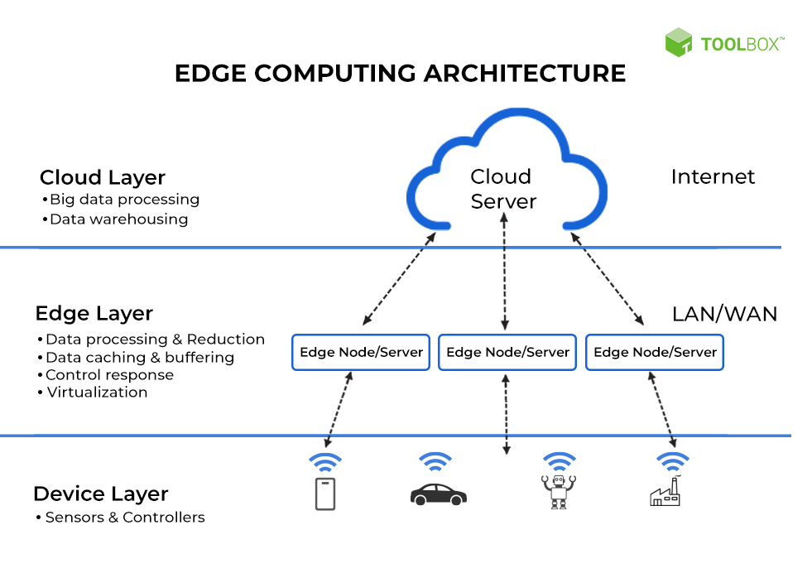

Slide 5
React Server Components
React Server Components are a new type of component architecture that allows developers to build server-side rendered React applications. React Server Components allow developers to write components that run on the server and then render them on the client.
React Server Components are designed to be more secure than traditional server-rendered applications as they are not exposed to the public, making them less susceptible to malicious attacks.

Slide 6
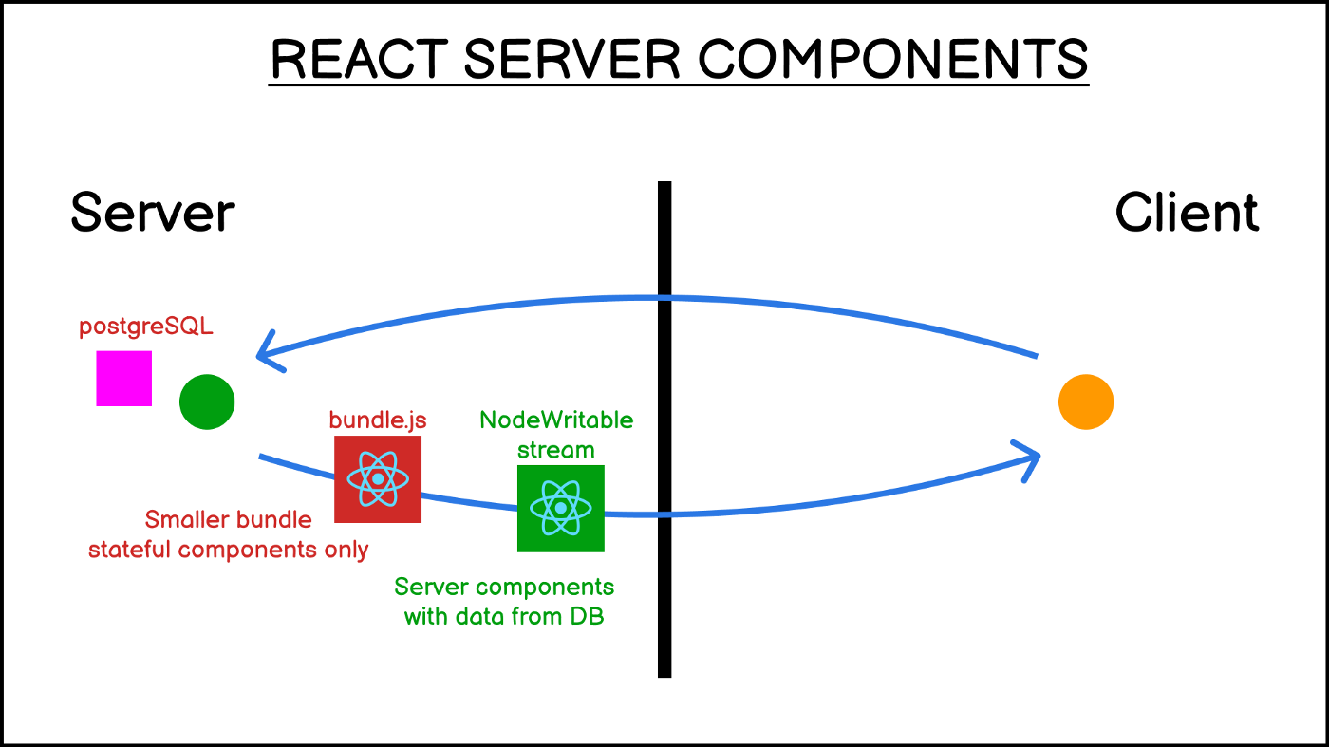

Slide 7
Vercel Edge Functions
Vercel Edge Functions are a service that allows developers to deploy serverless functions to the edge of the Vercel CDN, allowing them to respond to requests with minimal latency and improved performance.
This service can be used to create dynamic websites and applications, create custom APIs, and provide authentication and authorization. Additionally, Edge Functions can be triggered through Vercel’s API gateway or through webhooks from third-party services.

Slide 8
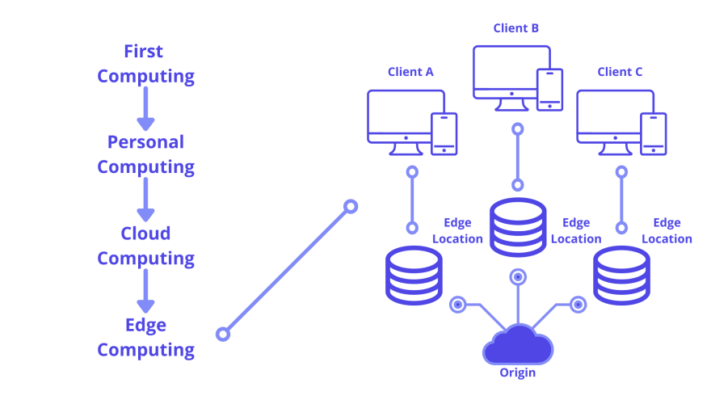

Slide 9
Type-Safe Database Access at the Edge with Nex13 & PlanetScale
Type-safe database access at the edge is a powerful tool that enables developers to easily and securely access data at the edge of the internet.
Next 13 and PlanetScale both offer type-safe database access services that allow developers to access the data in a secure manner.
Both companies also offer data replication services that enable developers to replicate their data across multiple nodes or locations.

Slide 10
What is Edge AI and How does it Work?
Edge AI is a type of artificial intelligence that runs on devices close to the data source, such as sensors or cameras, instead of in the cloud or a data center.
This enables the processing of data in real-time, reducing latency and providing faster output. Edge AI uses algorithms to process data locally, often using a combination of machine learning and deep learning.
This allows data to be analyzed quickly and accurately, without having to be sent to the cloud or a data center. Edge AI can be used for object recognition, facial recognition, natural language processing, and more.

Slide 11
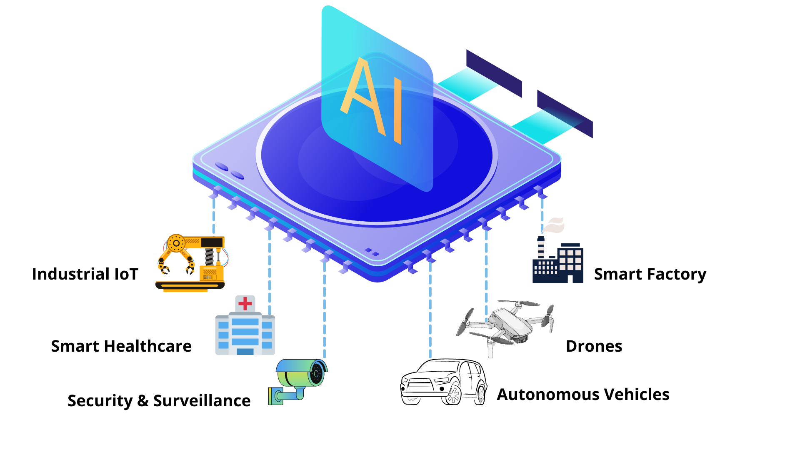

Slide 12
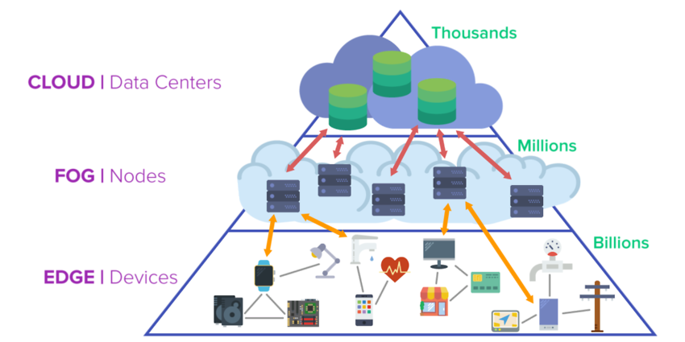

Slide 13
Finally, server-side components will become more prominent, allowing developers to build powerful and secure applications with fewer resources. React 18 and Next.js 13 will be the go-to frameworks for building web applications, as they are reliable, secure, and easy to use.
Prepared by
Rashid Rasheed PIAIC 94560
rashidrasheed@gmail.com
00923167634620

